Slide 1


Basic R Programming
Asst. Prof. Dr. Watshara Shoombuatong
Center of Data Mining and Biomedical Informatics
watshara.sho@mahidol.ac.th

Slide 2
Introduction
R is a programming language and environment commonly used in statistical computing, data analytics and scientific research.
It is one of the most popular languages used by statisticians, data analysts, researchers and marketers to retrieve, clean, analyze, visualize and present data.
Due to its expressive syntax and easy-to-use interface, it has grown in popularity in recent years.
https://www.datamentor.io/r-programming

Slide 3
Why use R for statistical computing and graphics?
R is open source and free!
R is free to download as it is licensed under the terms of GNU General Public license.
You can look at the source to see what’s happening under the hood. There’s more, most R packages are available under the same license so you can use them, even in commercial applications without having to call your lawyer.
https://www.datamentor.io/r-programming

Slide 4
Why use R for statistical computing and graphics?
R is popular – and increasing in popularity
IEEE publishes a list of the most popular programming languages each year. R was ranked 5th in 2016, up from 6th in 2015.
It is a big deal for a domain-specific language like R to be more popular than a general purpose language like C#.
This not only shows the increasing interest in R as a programming language, but also of the fields like Data Science and Machine Learning where R is commonly used.
https://www.datamentor.io/r-programming

Slide 5
Why use R for statistical computing and graphics?
R runs on all platforms
You can find distributions of R for all popular platforms – Windows, Linux and Mac.
R code that you write on one platform can easily be ported to another without any issues.
Cross-platform interoperability is an important feature to have in today’s computing world – even Microsoft is making its coveted .NET platform available on all platforms after realizing the benefits of technology that runs on all systems.
https://www.datamentor.io/r-programming

Slide 6
Why use R for statistical computing and graphics?
Learning R will increase your chances of getting a job
According to the Data Science Salary Survey conducted by O’Reilly Media in 2014, data scientists are paid a median of $98,000 worldwide. The figure is higher in the US – around $144,000.
Of course, knowing how to write R programs won’t get you a job straight away, a data scientist has to juggle a lot of tools to do their work.
Even if you are applying for a software developer position, R programming experience can make you stand out from the crowd.
https://www.datamentor.io/r-programming

Slide 7
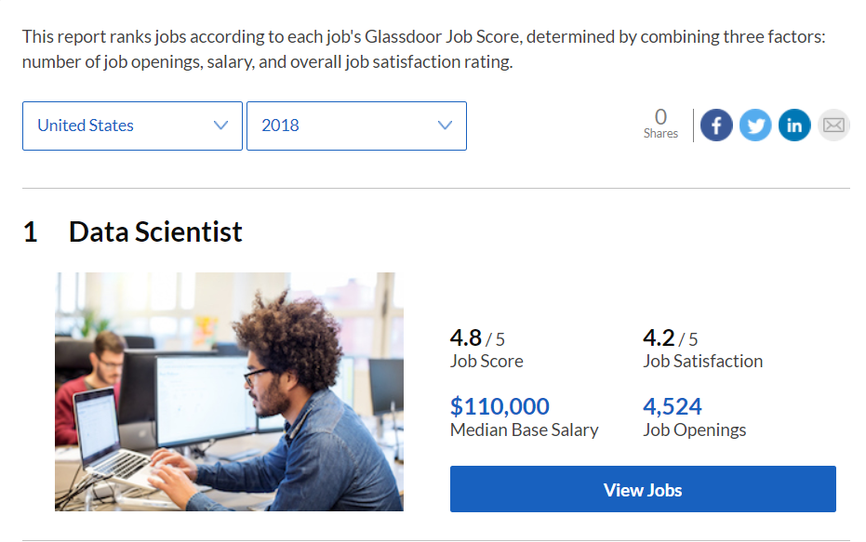
เกณฑ์การตัดสินจากจำนวนตำแหน่งงานที่เปิดรับ ข้อมูลฐานเงินเดือนเฉลี่ย และคะแนนเรตติ้งเกี่ยวกับโอกาสทางการงาน
‘Data Scientist เป็นหนึ่งในสาขาวิชาชีพที่กำลังมาแรงมากที่สุดในศตวรรษที่ 21’ จากตำแหน่งอาชีพที่แทบไม่มีใครรู้จัก
ในปี 2014 มหาวิทยาลัยนิวยอร์กได้เพิ่มหลักสูตรและปริญญาโทด้าน Data Science โดยเฉพาะ
Photo: glassdoor.com

Slide 8
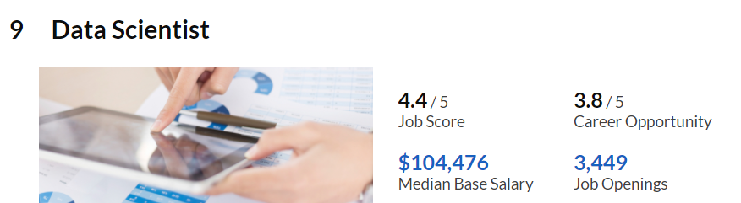
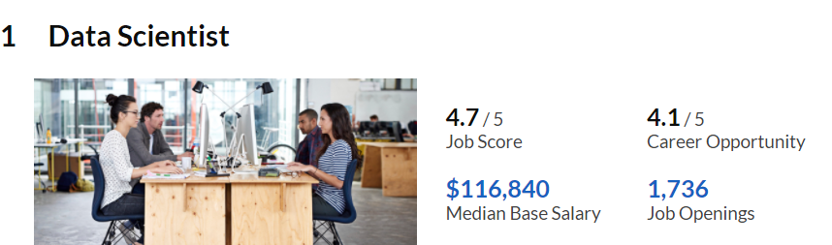
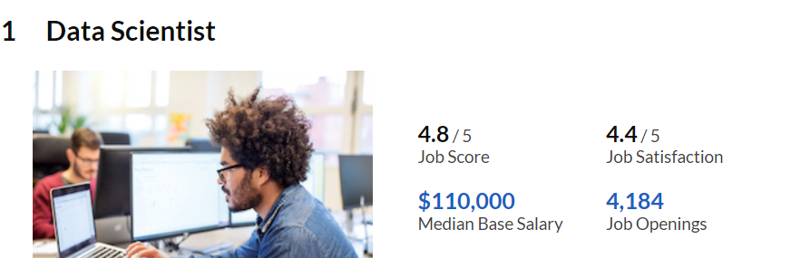
(2015)
ในปี 2014 มหาวิทยาลัยนิวยอร์กได้เพิ่มหลักสูตรและปริญญาโทด้าน Data Science โดยเฉพาะ
(2016)
(2017)
Photo: glassdoor.com

Slide 9
Demand For Data Scientists
Advertised machine learning skills are paying an average of $114,000.
Advertised data scientist jobs pay an average of $105,000.
Advertised data engineering jobs pay an average of $117,000.
https://www.forbes.com/sites/louiscolumbus/2017/05/13/ibm-predicts-demand-for-data-scientists-will-soar-28-by-2020/#3588cff27e3b

Slide 10

สำหรับประเทศไทย “EIC” เผยว่าอุปทานของ Data Scientist ในไทยยังมีอยู่ค่อนข้างน้อยเมื่อเทียบกับสหรัฐฯ จากการสืบค้นข้อมูลจาก LinkedIn พบว่าผู้ที่ระบุว่าตนเองทำงานเป็น Data Scientist ในไทยมีเพียง 200 บัญชี เทียบกับสหรัฐฯ ที่มี 44,000 บัญชี
แม้ว่าตอนนี้มหาวิทยาลัยในไทยจะเริ่มเปิดหลักสูตรเฉพาะทางด้าน Data Science แต่ก็มีอยู่เพียงไม่กี่แห่งเท่านั้น และจำนวนนักศึกษาที่ผลิตได้ก็ยังมีอยู่น้อย

Slide 11
แต่คาดว่าความต้องการ Data Scientist ในตลาดแรงงานจะมีมากถึง 2,000 คน
มีอัตราเติบโตเฉลี่ยอยู่ที่ประมาณ 15% ในช่วง 2 – 3 ปีข้างหน้า
ในอนาคตอันใกล้จึงมีความเป็นไปได้สูงที่บริษัทต่างๆ ทั้งธุรกิจขนาดใหญ่ในหลายอุตสาหกรรม ตลอดจนธุรกิจ start-up และ SMEs ด้านเทคโนโลยี จะต้องการ Data Scientist มากขึ้นเพื่อสร้างองค์ความรู้จากข้อมูลขนาดใหญ่ที่มีอยู่

Slide 12


Slide 13
Why use R for statistical computing and graphics?
R is being used by the biggest tech giants
Adoption by tech giants is always a sign of a programming language’s potential. Today’s companies don’t make their decisions on a whim. Every major decision has to be backed by concrete analysis of data.
Companies Using R: R is the right mix of simplicity and power, and companies all over the world use it to make calculated decisions.
https://www.datamentor.io/r-programming

Slide 14
Applications of R Programming in Real World
Data Science
A data scientist is a statistician with an extra asset: computer programming skills.
Programming languages like R give a data scientist superpowers that allow them to collect data in real-time, perform statistical and predictive analysis, create visualizations and communicate actionable results to stakeholders.
Most courses on data science include R in their curriculum because it is the data scientist’s favorite tool.
https://www.datamentor.io/r-programming

Slide 15
Applications of R Programming in Real World
Statistical computing
R is the most popular programming language among statisticians.
In fact, it was initially built by statisticians for statisticians. It has a rich package repository with more than 9100 packages with every statistical function you can imagine.
R’s expressive syntax allows researchers – even those from non computer science backgrounds to quickly import, clean and analyze data from various data sources.
R also has charting capabilities, which means you can plot your data and create interesting visualizations from any dataset.
https://www.datamentor.io/r-programming

Slide 16
Applications of R Programming in Real World
Machine Learning
R has found a lot of use in predictive analytics and machine learning.
It has various package for common ML tasks like linear and non-linear regression, decision trees, linear and non-linear classification and many more.
Everyone from machine learning enthusiasts to researchers use R to implement machine learning algorithms in fields like finance, genetics research, retail, marketing and health care.
https://www.datamentor.io/r-programming

Slide 17
Types of data and variables
The first step in choosing an appropriate statistical method is to recognize the type of data.
From a basic statistical point of view there are two main types of data: categorical and numerical.

Slide 18
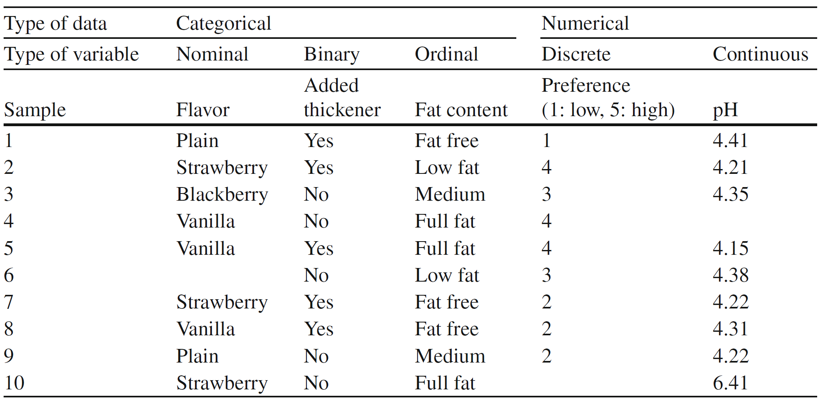
Types of data and variables

Slide 19
Types of data and variables
Data that fall under nominal variables (e.g., “ ﬂavor” ) are comprised of categories
Other typical examples of numerical data in food science are food group (e.g., dairy, meat, vegetables), method of conservation (e.g., canned, dried, vacuum packed)

Slide 20
Types of data and variables
Statistically, nominal variables contain less information than ordinal or numerical variables.

Slide 21
Types of data and variables
If measurements can only be grouped into two mutually exclusive groups, then
the data are called binary (also called dichotomous).

Slide 22
Types of data and variables
Binary data can always be reported in the form of yes or no (coded as 1 and 0, respectively). esearch Methodology

Slide 23
Types of data and variables
Data presented by their relative order of magnitude, such as the variable “fat
content” , are ordinal
It has a natural order of magnitude with more
than two categories, it contains more statistical information than nominal and binary data.

Slide 24
Types of data and variables
Ordinal data can be simpliﬁed into binary data – e.g., reduced fat (combining
the categories fat free, low fat, and medium fat) or nonreduced (full fat), but with a concomitant loss of information

Slide 25
Types of data and variables
Observations that are measurable on a scale are numerical data.
Observations that can take only integers (no decimals)
are denoted discrete data.

Slide 26
Types of data and variables
The “distance” between discrete variables is assumed to be the same.
For instance the difference in preference between a score of 2 and 3 is assumed to be the same as the difference between scores 4 and 5.

Slide 27
Types of data and variables
Continuous data are measured on a scale and can be expressed with decimals.

Slide 28
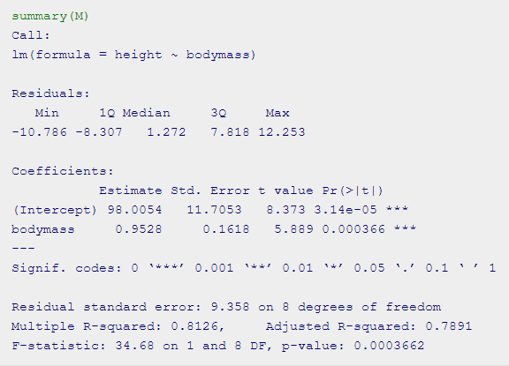
Linear Regression Example in R using lm() Function
The lm function really just needs a formula (Y~X) and then a data source.
The independent variable or the predictor variable will be bodymass.
The dependent variable, also sometimes called the outcome variable, (the one we’re trying to predict) will be height.
http://www.ucl.ac.uk/~uctqiax/PUBLG100/2016/week4/seminar4.html

Slide 29
Linear Regression Example in R using lm() Function
The differences between the observed values and the predicted values are called residuals.
Smaller residuals are better.
We can see that the linear model has a range for the residuals: -10.786 – 12.253.
http://www.ucl.ac.uk/~uctqiax/PUBLG100/2016/week4/seminar4.html

Slide 30
Linear Regression Example in R using lm() Function
The coefficients for the intercept and the independent variables. Using the coefficients we can write down the relationship between the dependent and the independent variables as:
height = 98.0054 + ( 0.9528 * bodymass )
This tells us that for each unit increase in the variable bodymass, the height increases by 0.9528.
http://www.ucl.ac.uk/~uctqiax/PUBLG100/2016/week4/seminar4.html

Slide 31
Linear Regression Example in R using lm() Function
The p-value of the model. Recall that according to the null hypotheses, the coefficient of interest is zero.
The p-value tells us whether can reject the null hypotheses or not.
http://www.ucl.ac.uk/~uctqiax/PUBLG100/2016/week4/seminar4.html

Slide 32
Linear Regression Example in R using lm() Function
The standard error estimates the standard deviation of the coefficients in our model.
We can think of the standard error as the measure of precision for the estimated coefficients.
http://www.ucl.ac.uk/~uctqiax/PUBLG100/2016/week4/seminar4.html

Slide 33
Linear Regression Example in R using lm() Function
The R-squared and adjusted R-squared tell us how much of the variance in our model is accounted for by the independent variable.
The adjusted R-squared is always smaller than R-squared as it takes into account the number of independent variables and degrees of freedom.
http://www.ucl.ac.uk/~uctqiax/PUBLG100/2016/week4/seminar4.html

Slide 34
Linear Regression Example in R using lm() Function
P-value is less than significance level (< 0.05), we can safely reject the null hypothesis that the coefficient β of the predictor is zero.
Our model p-value is very significant (approximately 0.0004) and we have very good explanatory power (over 81% of the variability in height is explained by body mass).
http://www.ucl.ac.uk/~uctqiax/PUBLG100/2016/week4/seminar4.html

